Slide 1
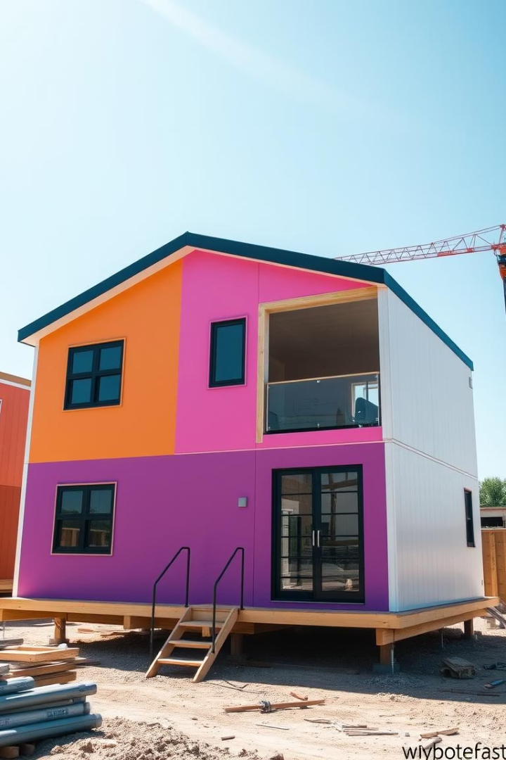
Modular Housing: Opportunities in Washington State
This presentation explores the modular housing market in Washington State, focusing on key players, market potential, and regulatory considerations. We will examine company profiles, product offerings, and the advantages of modular construction.
By Eileen Chen and Lindsey Allen
RE465

Slide 2
Method Homes: Company Profile
Company Overview
Marketing Strategies
Product Offerings
Method Homes is located in Seattle, with a factory in Ferndale, WA. They target the higher end of the prefab market, seeking customers and architect partners.
They use a strong website, social media engagement (Instagram, Pinterest), and emphasize sustainability and energy efficiency in their building practices.
Models range from 300-615 sq ft, with prices from $65,900 to $97,500. Prices include base home, appliances, and standard finishes.

Slide 3
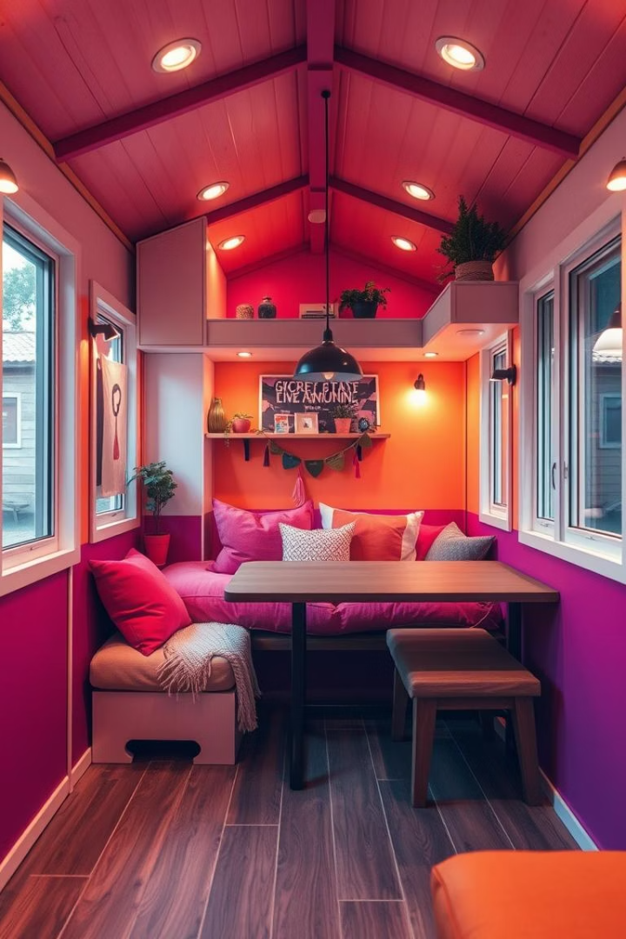
Wolf Industries: Company Profile
Company Overview
Marketing Strategies
Wolf Industries is based in Battle Ground, WA, with locations in Oregon. They manufacture modular tiny houses.
They have a strong online presence, active social media, and partnerships with organizations like Tiny House Alliance USA. They also use content marketing.
Target Audience
Their customers include ADU seekers, first-time homebuyers, investors, and those needing emergency housing.

Slide 4




Modular Housing Market Potential
Affordable Housing Need
ADU & Urban Density
Growing demand for more affordable housing solutions.
Increase in Accessory Dwelling Unit (ADU) development and urban density initiatives.
Eco-Friendly Interest
Rising interest in eco-friendly and energy-efficient homes.

Slide 5
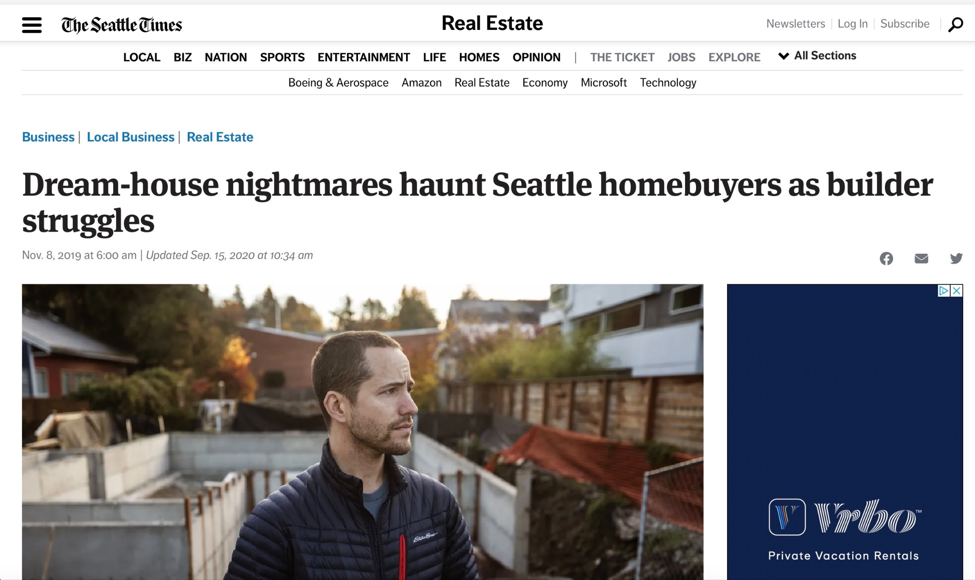
https://www.seattletimes.com/business/real-estate/prefabricated-dream-homes-turn-into-unfinished-nightmares-as-builder-struggles/

Slide 6
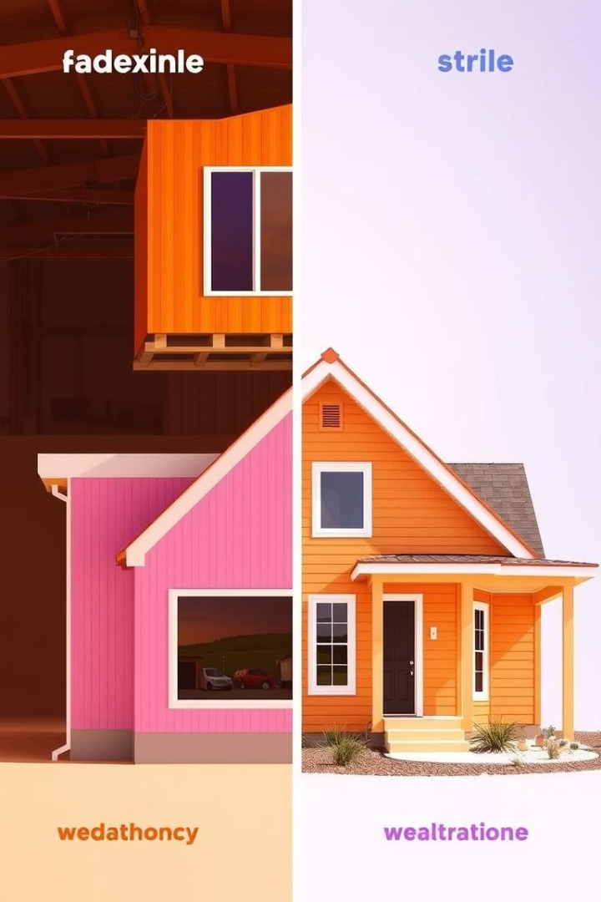
Modular vs. Standard Housing
Feature
Modular Housing
Standard Housing
Construction Time
Faster (factory assembly)
Slower (on-site build)
Cost
Generally more affordable
Higher
Customization
Various options, some limitations
Highly customizable
Quality Control
Consistent (factory checks)
Varies (on-site conditions)

Slide 7


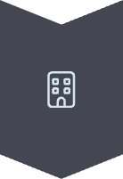


Permitting & Placement in WA
Varies by County
Permitting requirements differ significantly across Washington counties.
State Building Code
Modular homes must comply with Washington State Building Code standards.
Seattle Zoning
Seattle has specific zoning regulations for ADUs and DADUs.
Assistance Available
Companies like Method Homes assist with digital document submission and fees.

Slide 8

Cost to Build in Washington
$100-$250
$80K-$200K
$150K-$400K
Per Square Foot
1-Bedroom Home
3-Bedroom Home
Typical range for modular homes, depending on customization.
Average total cost estimate for a single-bedroom unit.
Average total cost estimate for a larger three-bedroom unit.

Slide 9

Key Takeaways & Next Steps
Research Local Companies
Explore companies like Wolf Industries, NODE, and Blokable.
Understand Regulations
Consult local departments for specific permitting and zoning rules.
Consider Funding
Investigate programs like the Oregon Modular Housing Development Fund.

